Slide 1
Our Journey so far…

Slide 2
Why Inclusive Orkney was created
Build relationships and connections
Fun
Passion
Skill development
Dedication
To provide opportunities
Support families

Slide 3
Our key aims
Support
Community
Opportunities
Belonging

Slide 4
Our vision To support and create inclusive opportunities in orkney

Slide 5
Our mission To provide comprehensive signposting to services, work collaboratively with key partners to deliver arts, sports, music and theatrical opportunities through support sessions, raise awareness of additional support needs and play an active role in the wider community.

Slide 6
Our ORIGINAL sponsors
Eddie Frasers R S Rendall B&L Builders

Slide 7
Facebook page

Slide 8
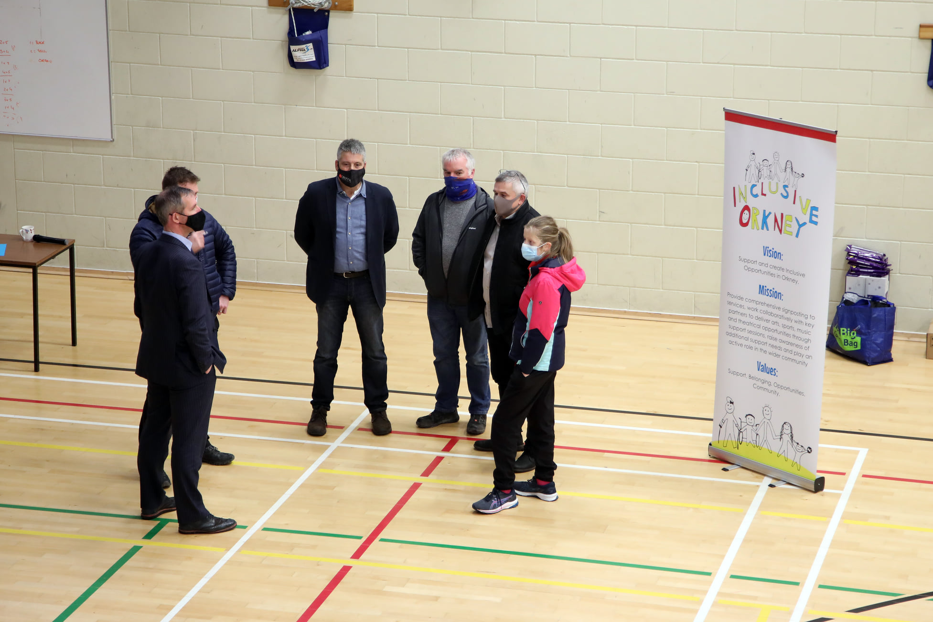
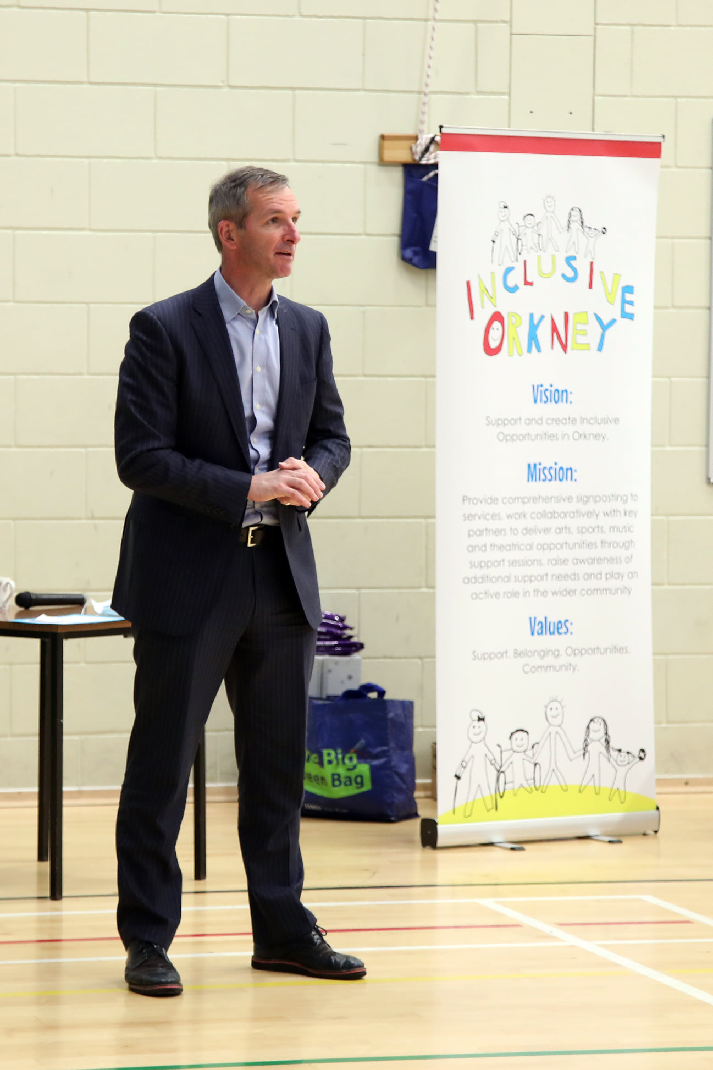
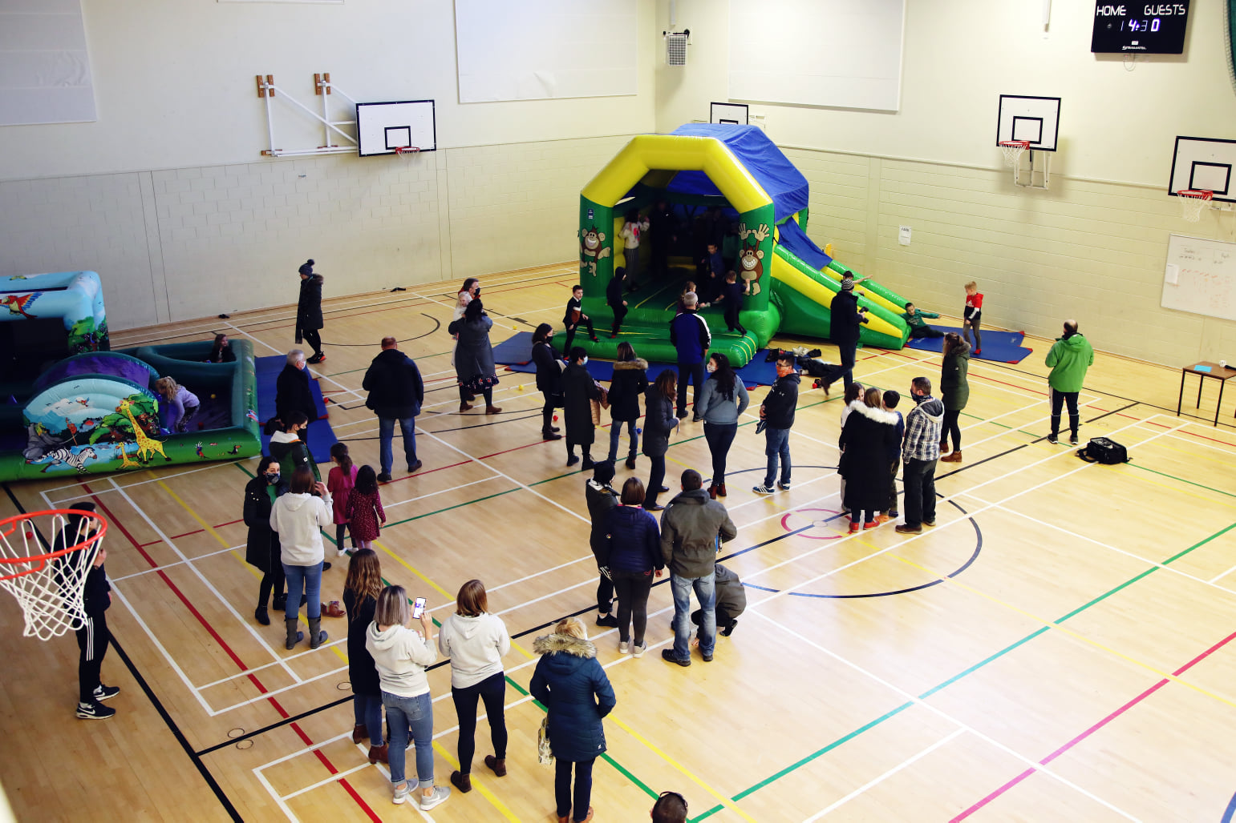
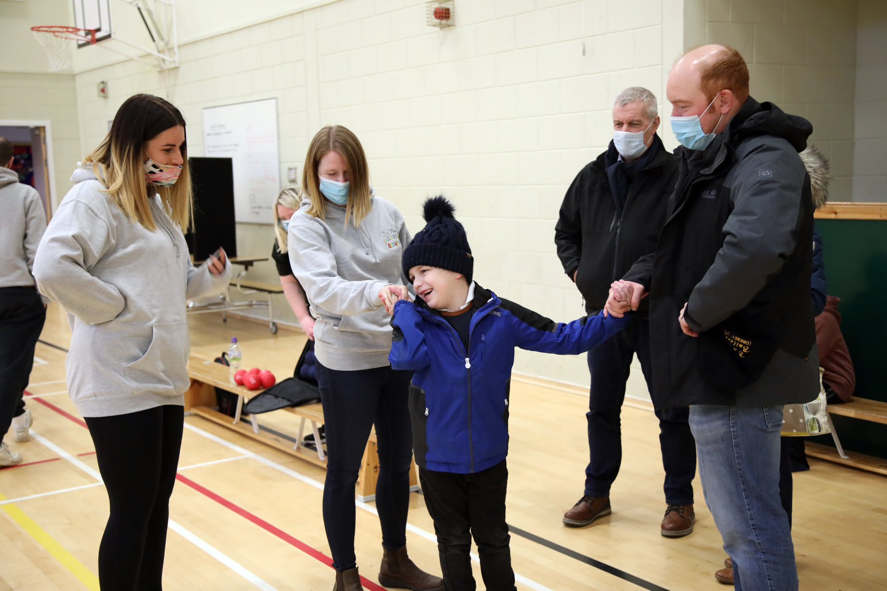
Inclusive Orkney launch 2021

Slide 9
Successful funding applications/ donations to buy resources for weekend club

Slide 10
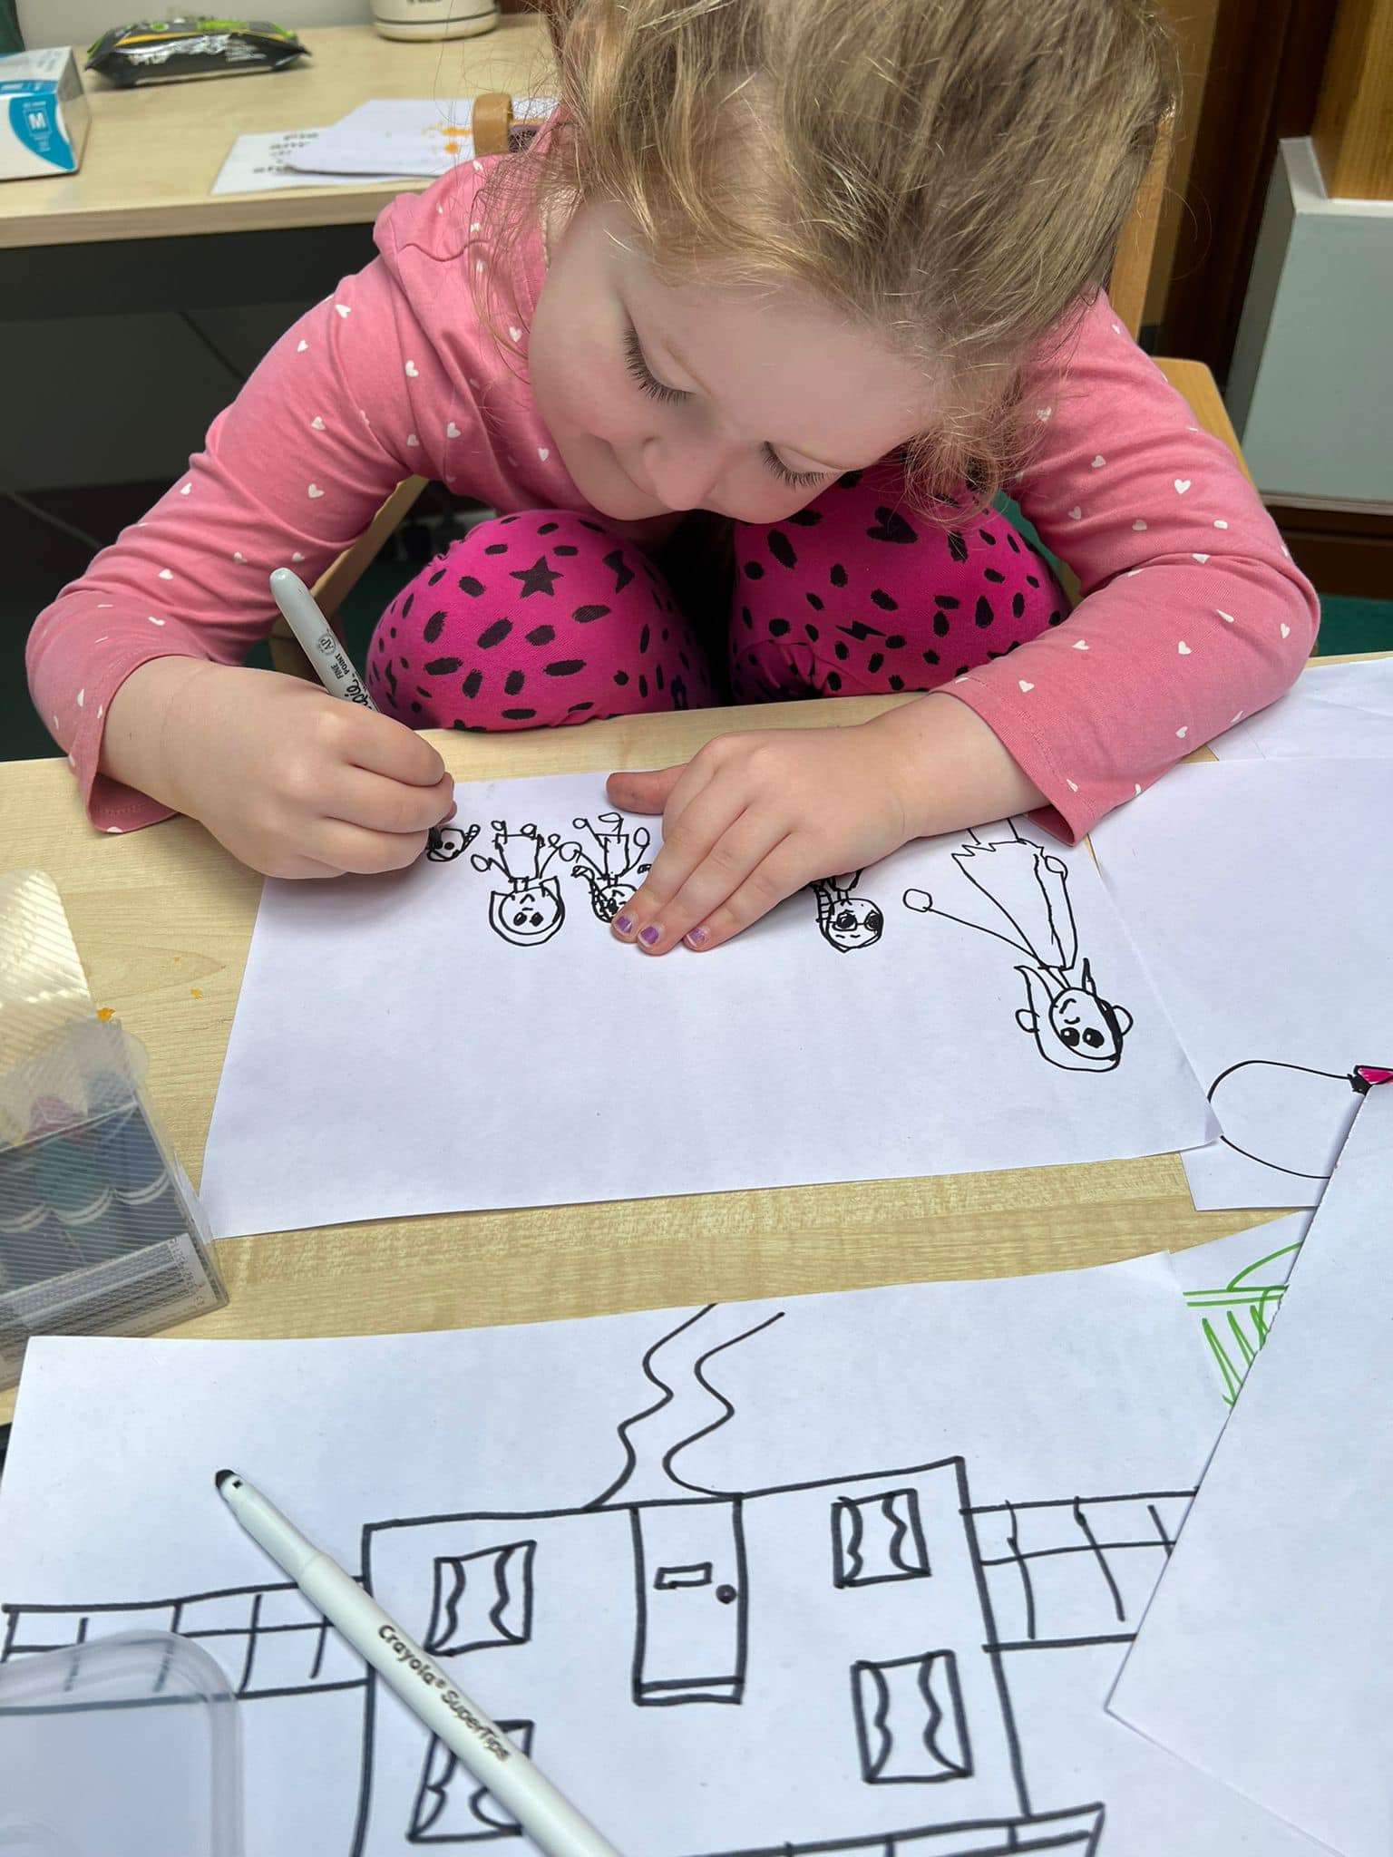
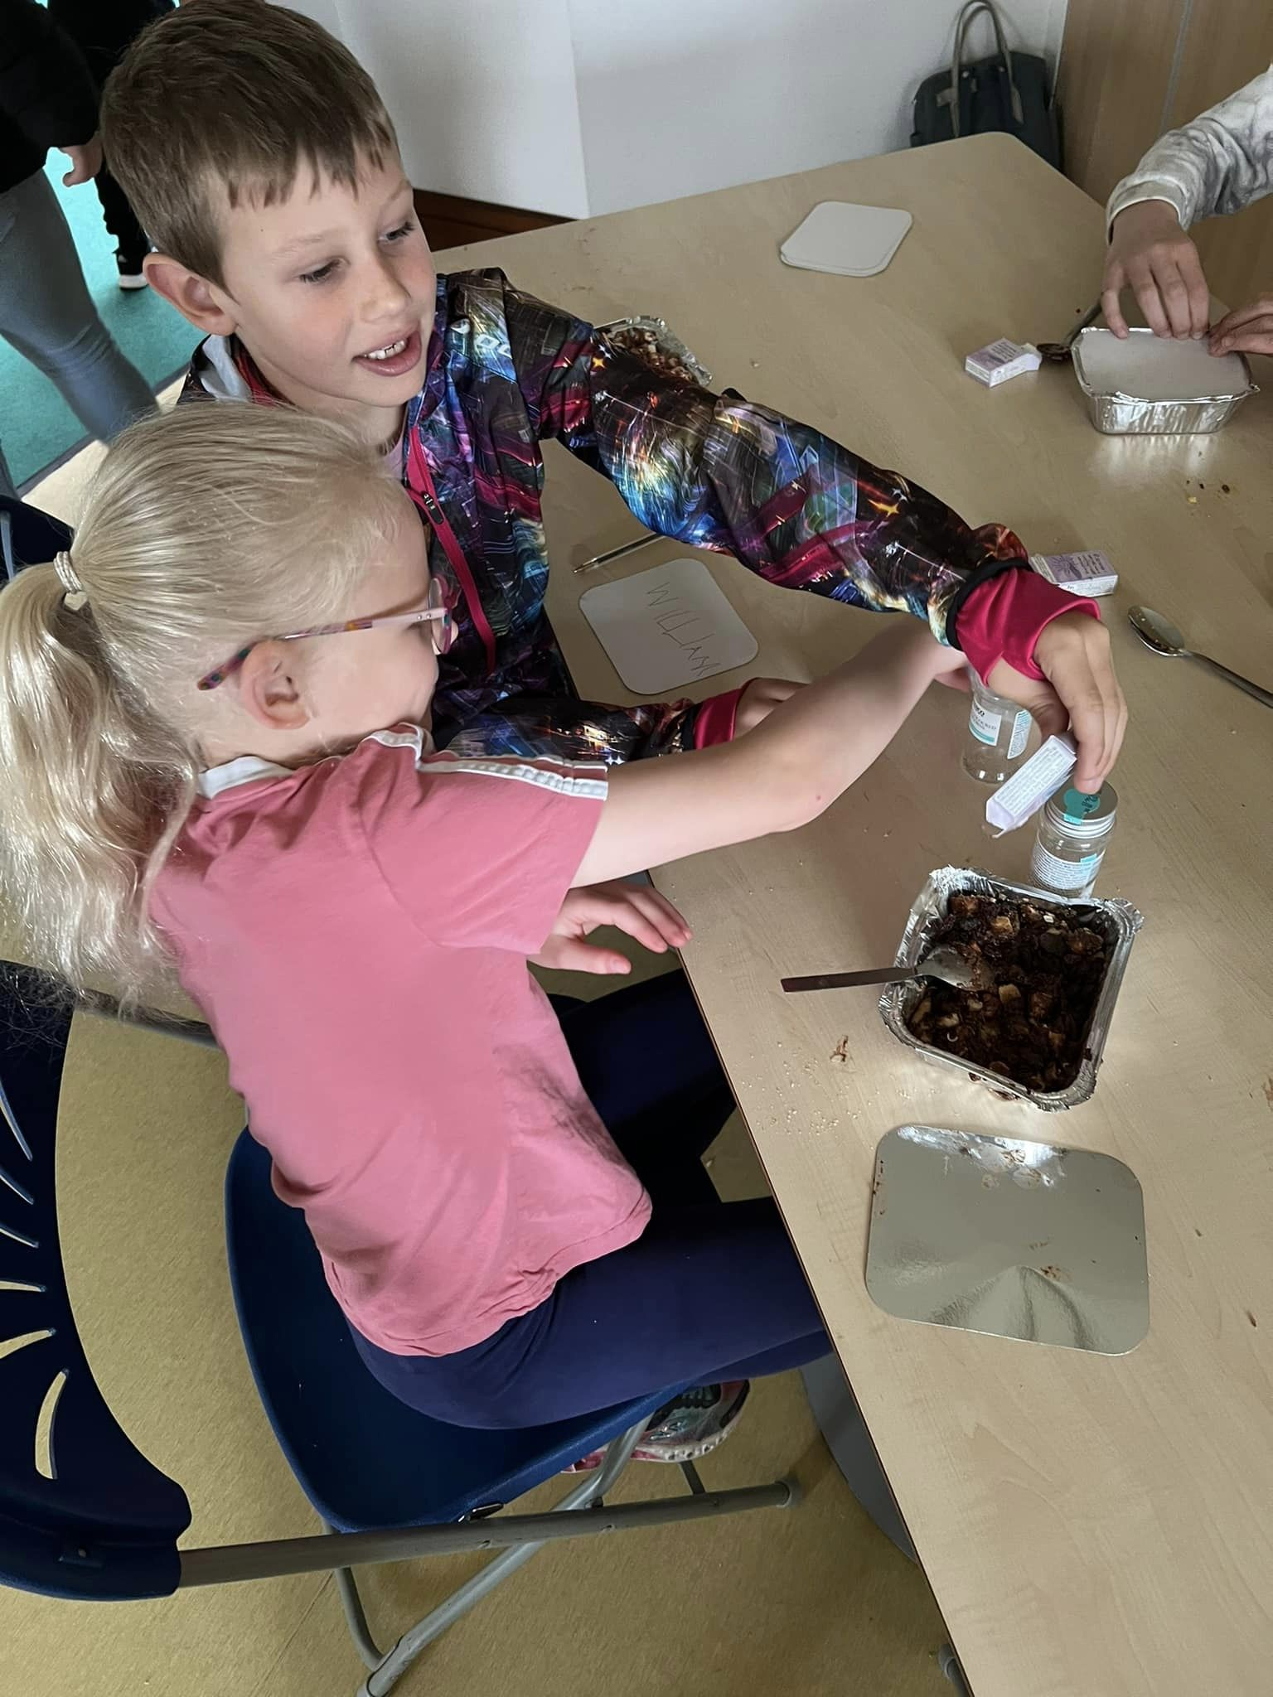
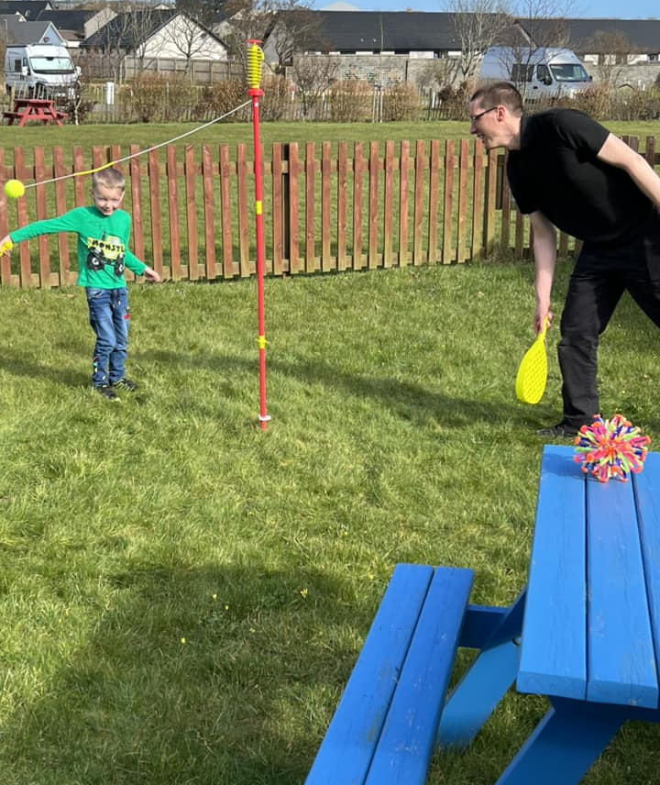
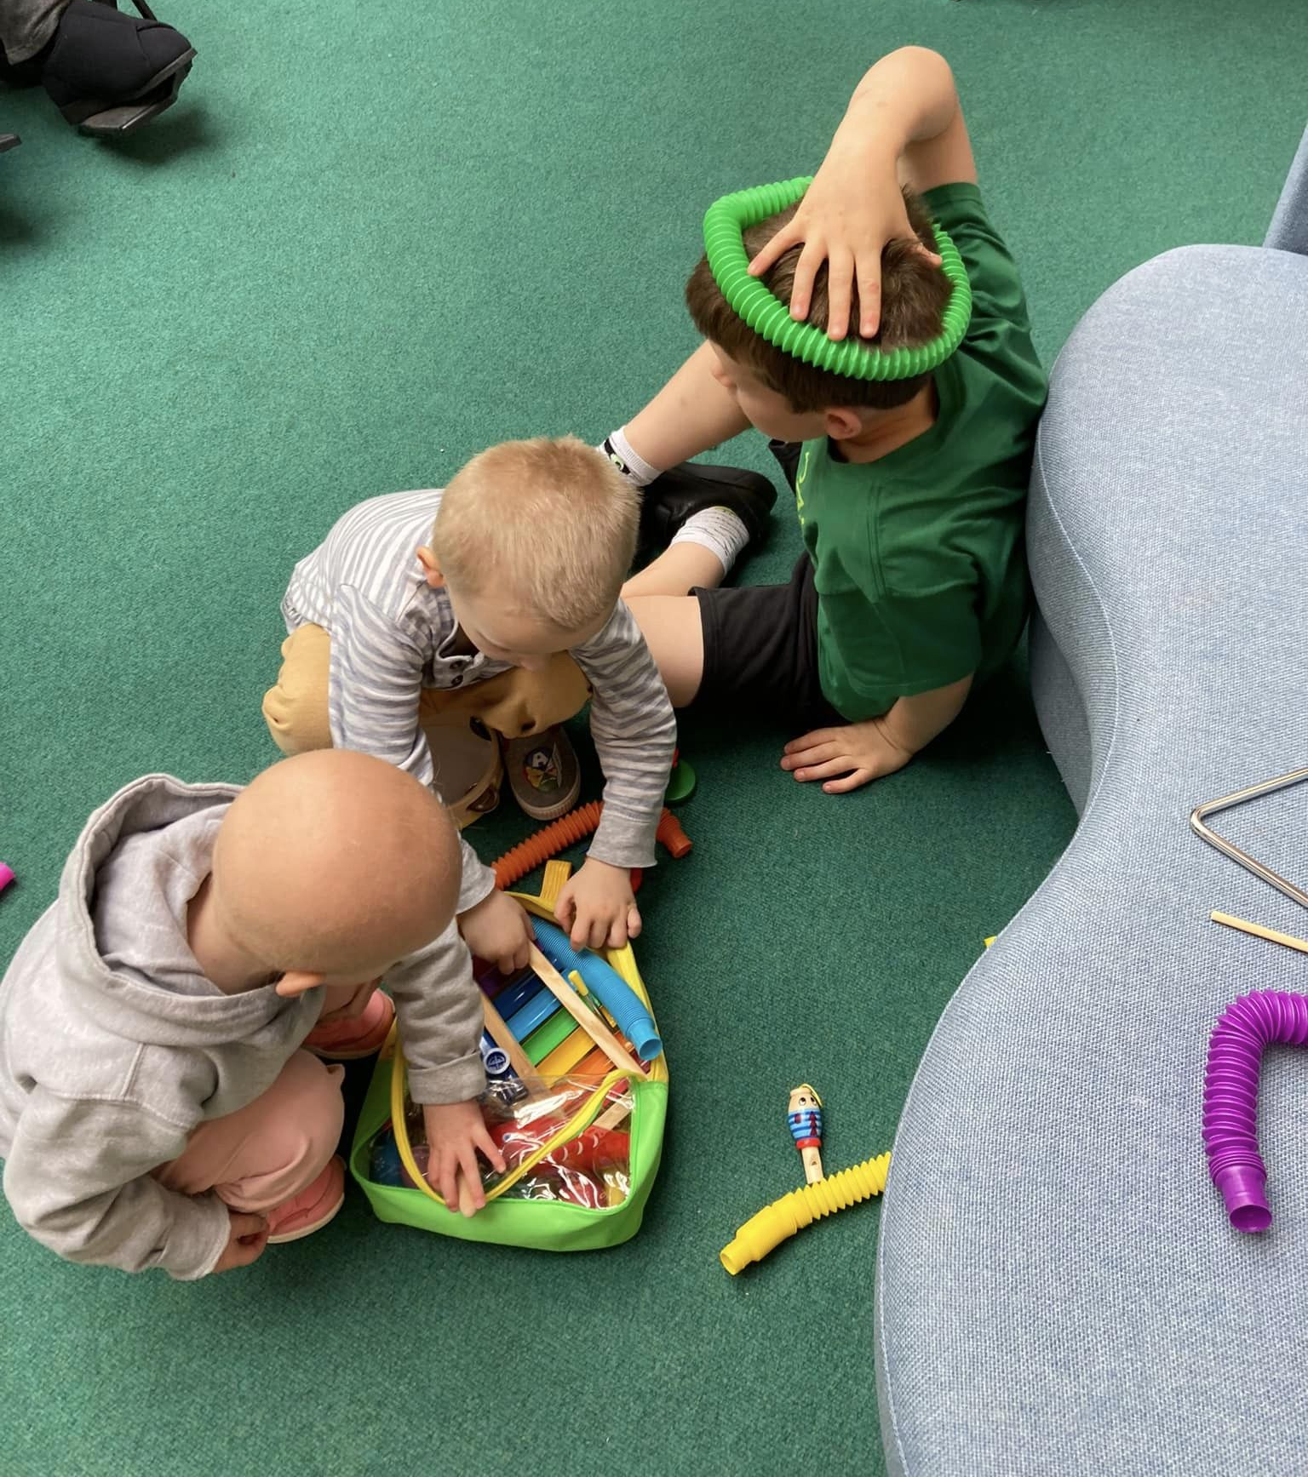
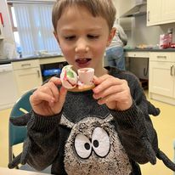
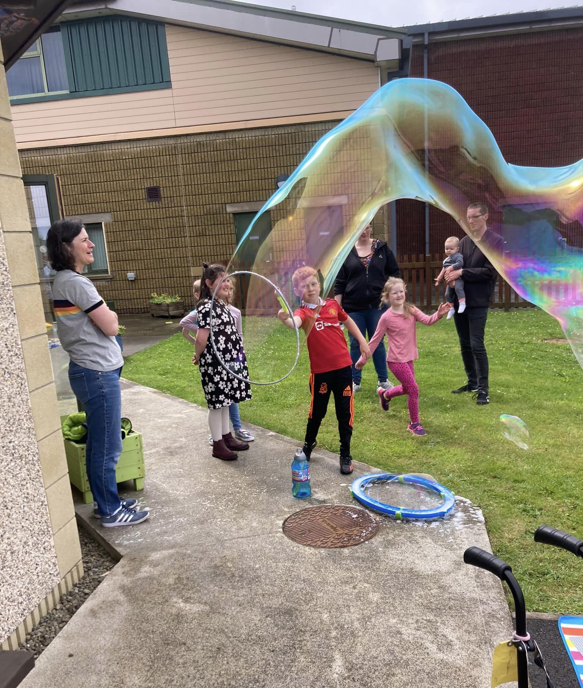
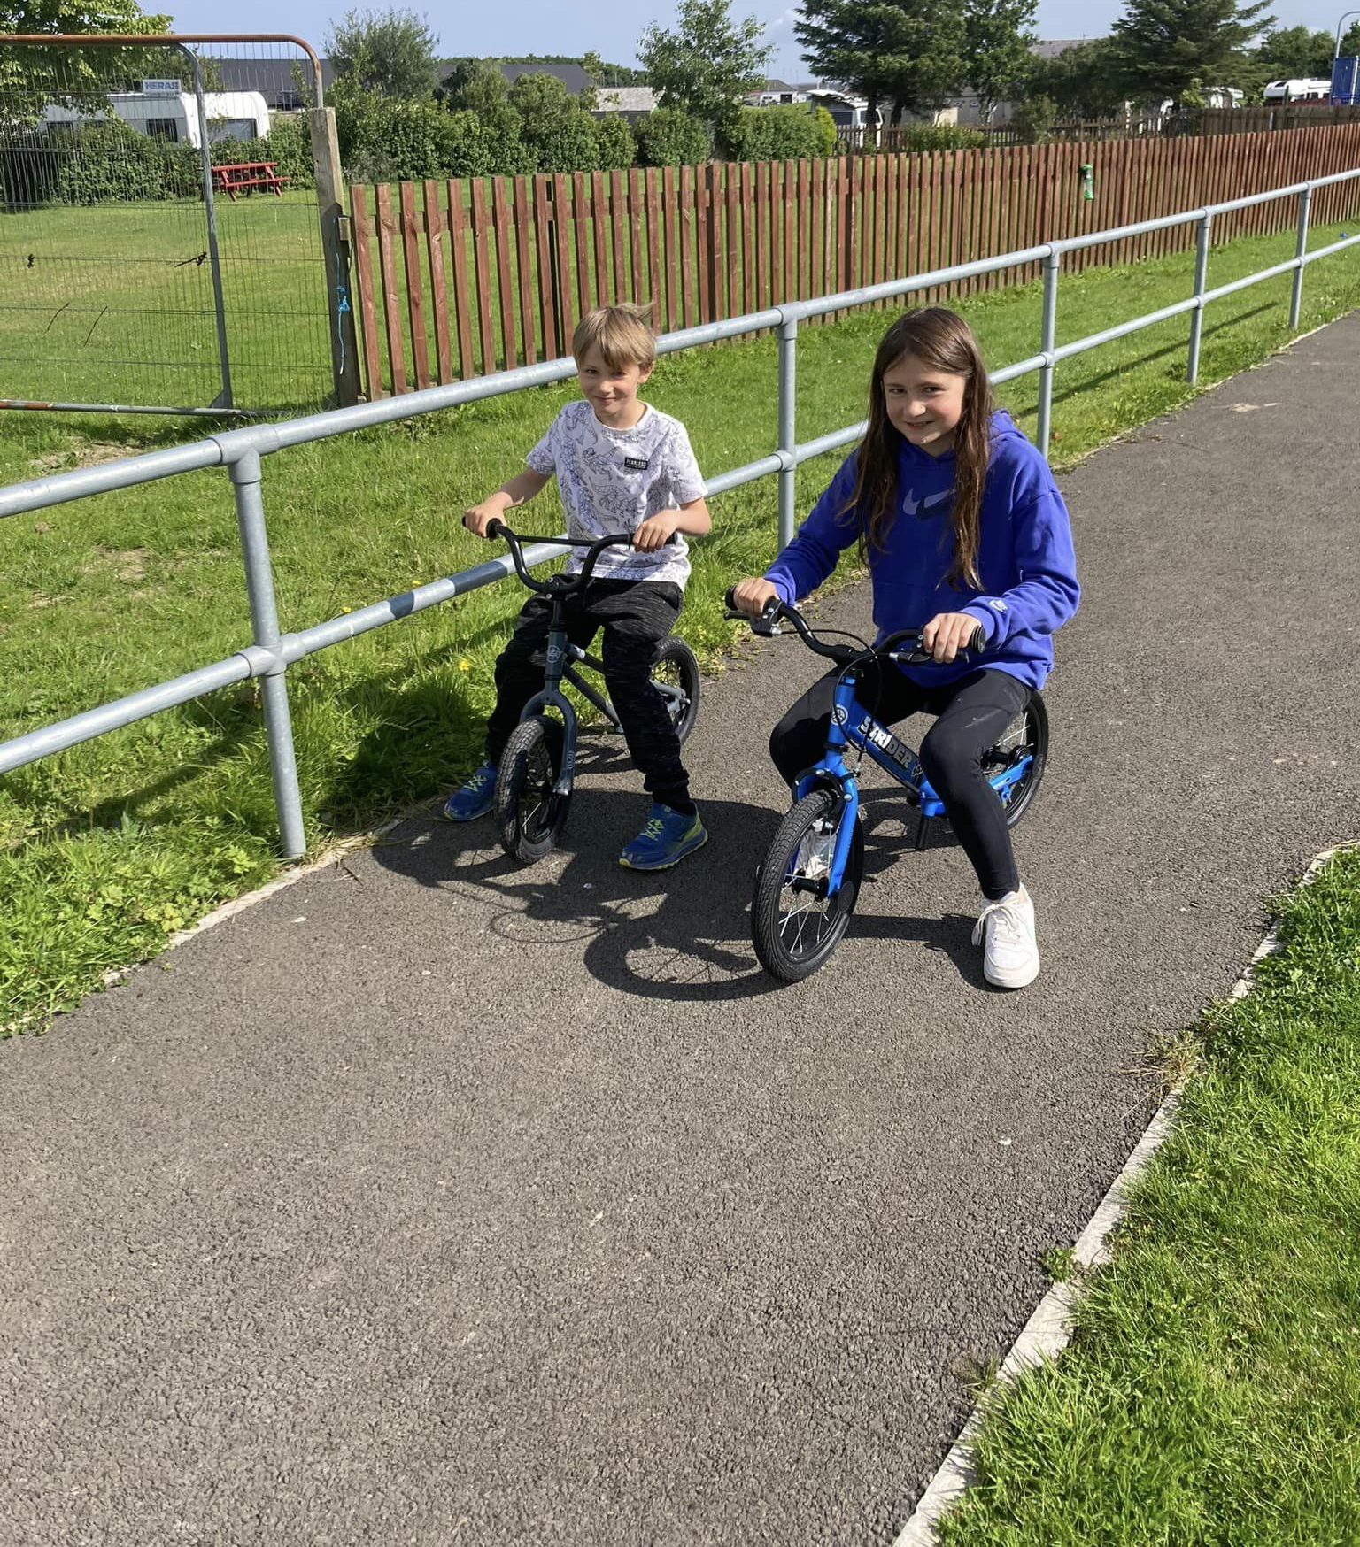
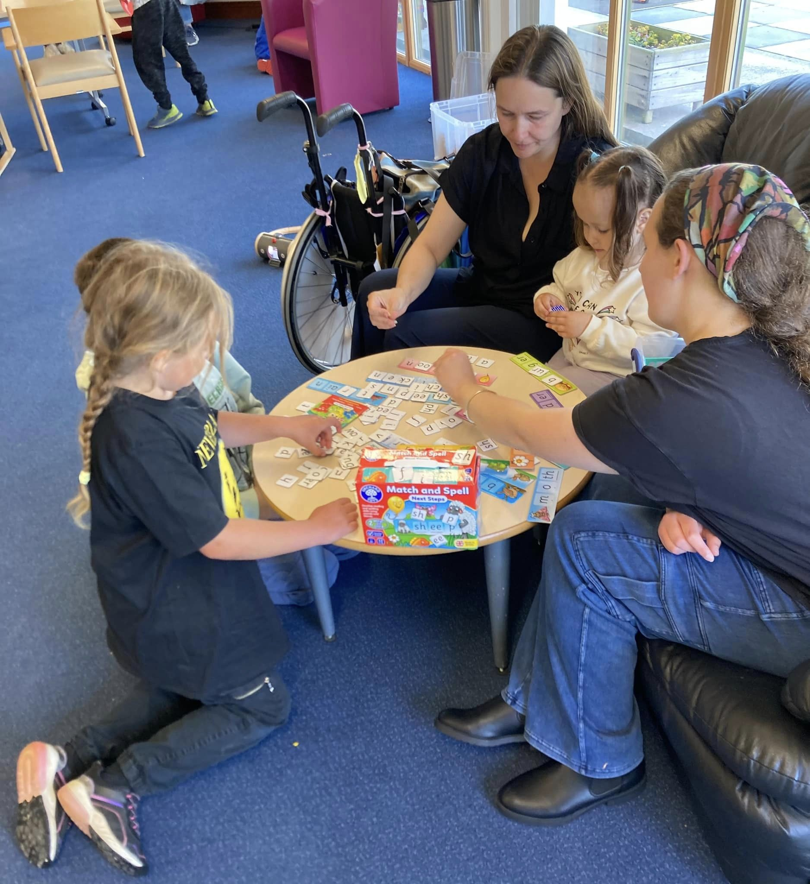
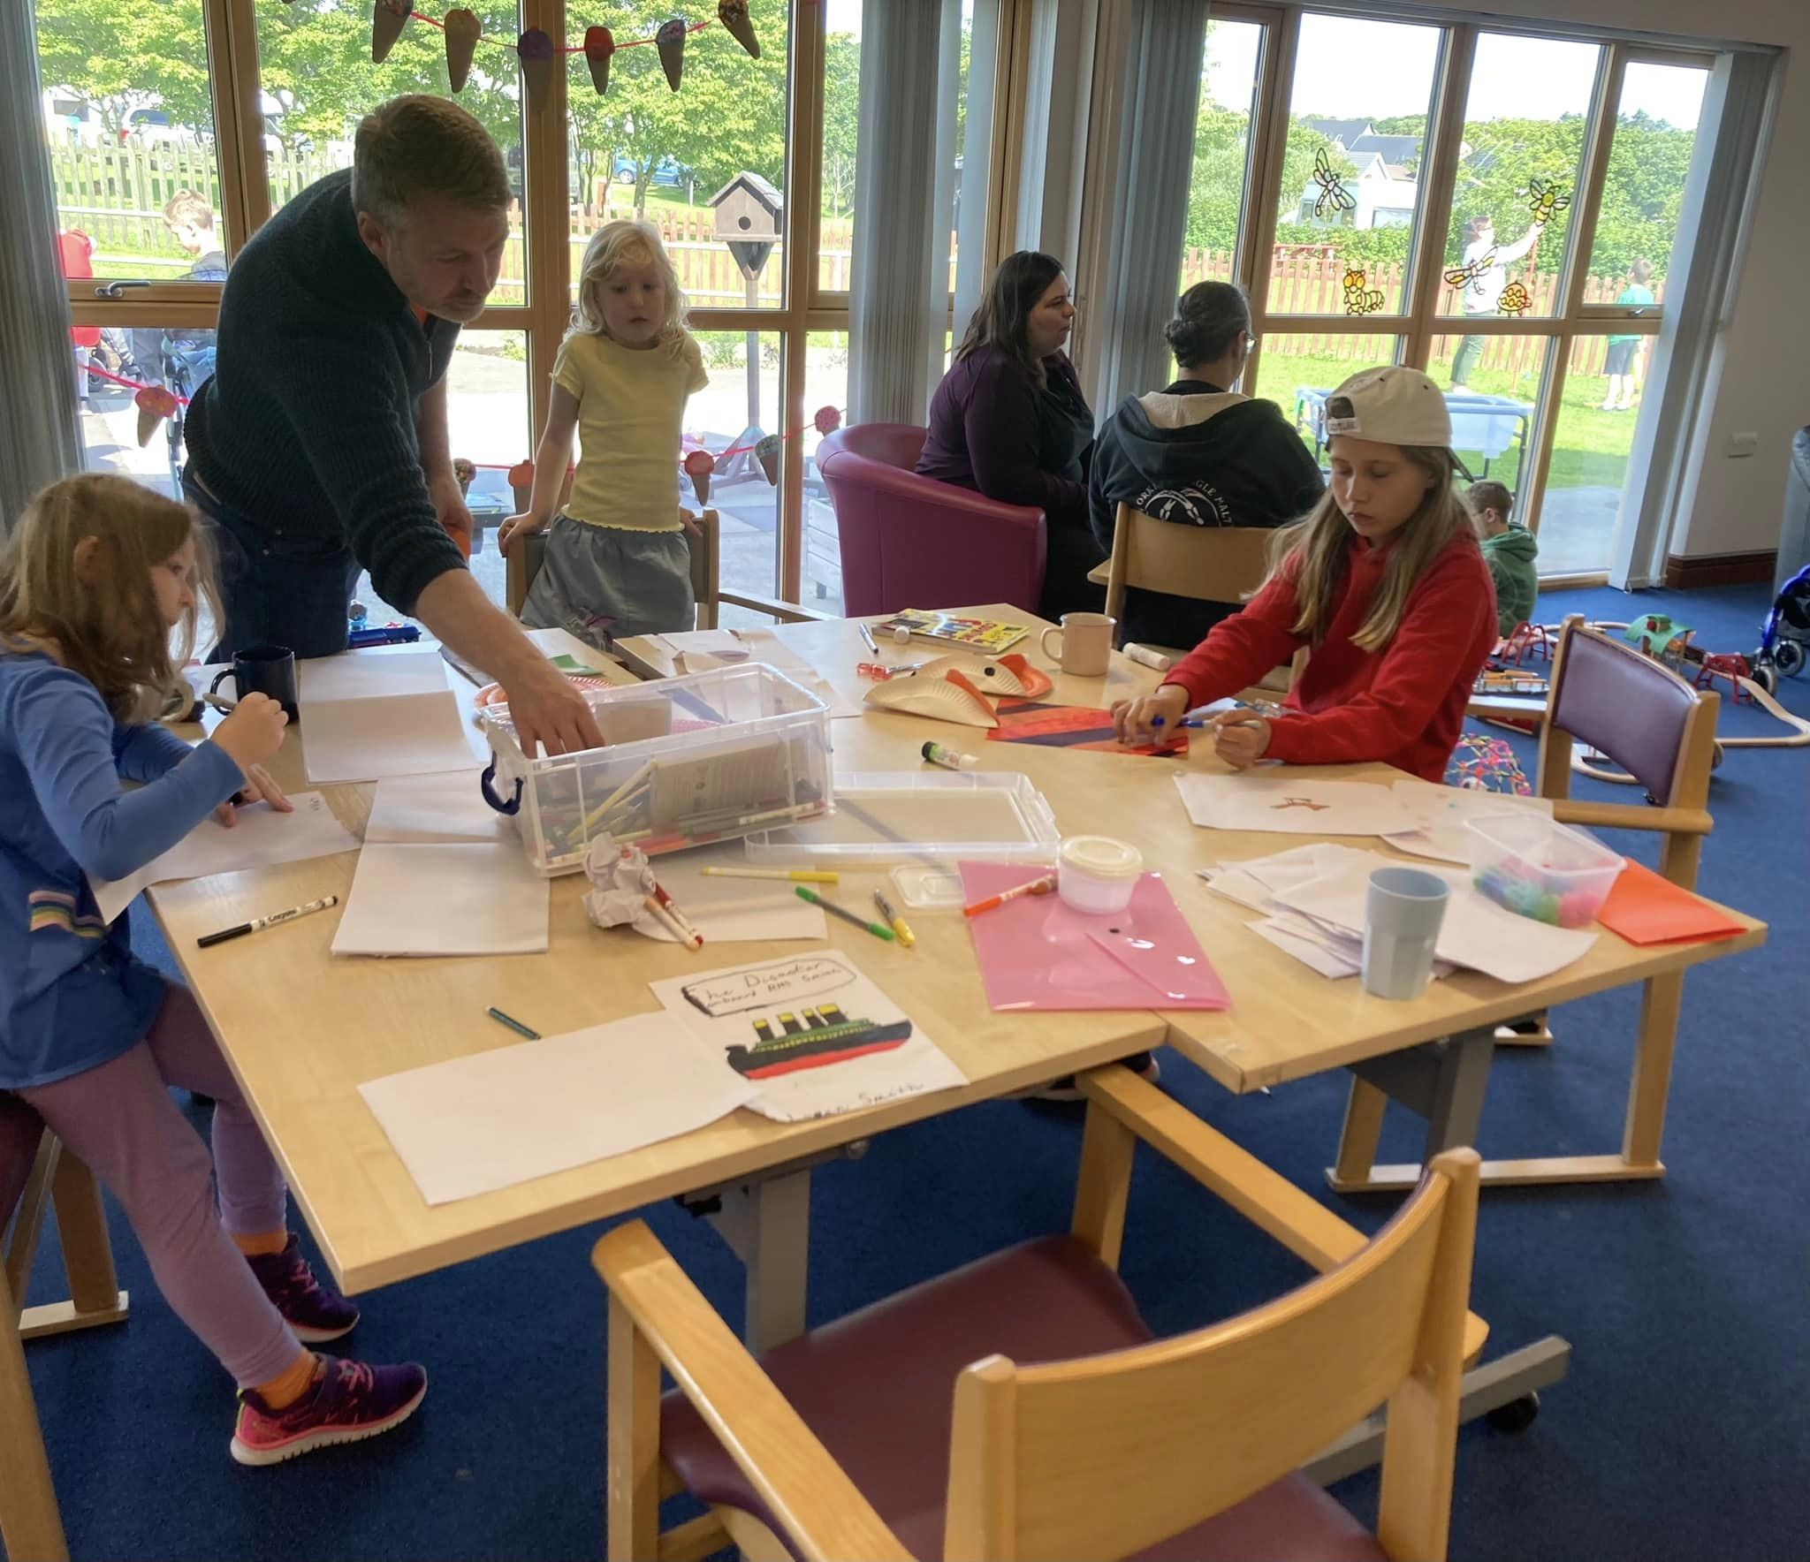
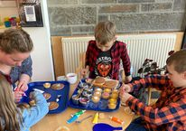
Weekend club the first sunday of each month at lifestyles

Slide 11
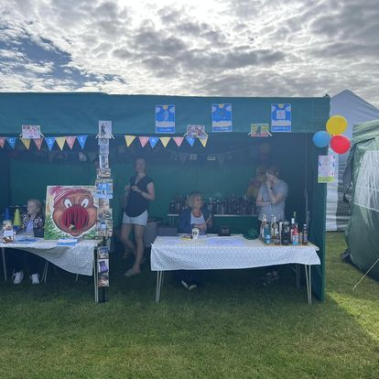
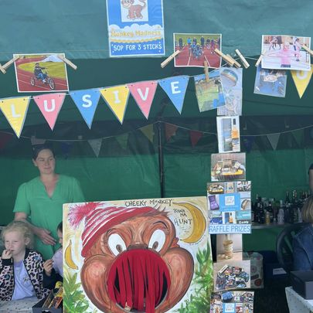
County show 2022 and 2023

Slide 12
2023 successes
February Coffee morning
Lifestyles as our venue for Weekend club
Our first family picnic
We have provided part funded holiday activities
We have worked in partnership with the council to provide more inclusive opportunities for children with additional support needs with Government funding
Increased awareness in community
An increase in committee members and volunteers
Fundraising at the Peedie Cubby
Weekend club and Christmas Party sell outs

Slide 13
2024 for Inclusive Orkney
Launch of our Inclusive Orkney Website January 2024
New Years Party
Coffee morning
Weekend clubs/ exploration of other possible opportunities
Working in partnership to provide Easter, Summer and October holiday activities for children with additional support needs
Family picnic
Blue Door
Dounby and County Show
Craft Fayre
Christmas party

